Slide 1
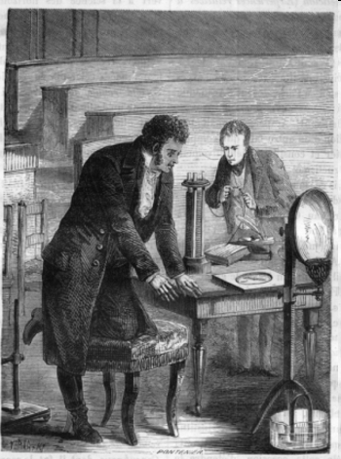
History of Electromagnetism
For centuries, people believed that electricity and magnetism were somehow related. In 1819,
the Danish physicist Hans _________________(1777–1851) discovered the connection by accident while lecturing on electric circuits at the University of
Copenhagen.

Slide 2
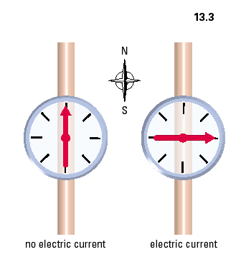
Oersted’s Discovery

Slide 3
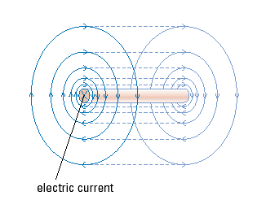
• The magnetic field forms concentric ________ around the wire
The field lines are spaced__________ apart the farther you
from the wire which shows the field strength gets _______.
The field lines ___________ through space (are 3-D).
The 3D Magnetic Field around a Straight
Conductor

Slide 4

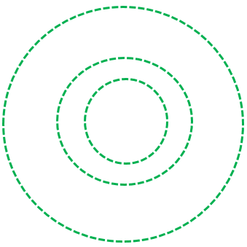
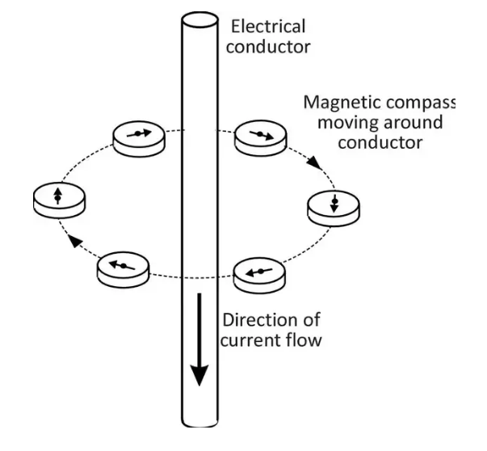
Mapping the Field of a Wire in Two Dimesions
Top view- Current going _______ from you
Bottom view- Current going _______ you

Slide 5
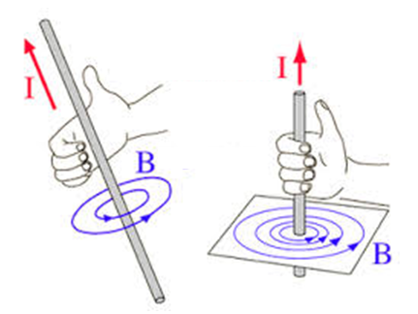
Right Hand Rule #1
Current passing through a straight wire produces a circular magnetic field.
_______________________________
__________________________________
I- direction of conventional current flow
B-magnetic field pattern

Slide 6
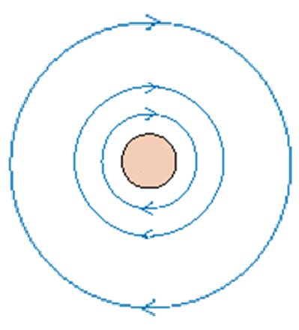
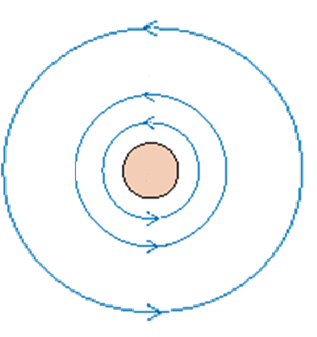
2-D representation:
Conventional current flows
“into” the page
Conventional current flows
out of the page

Slide 7
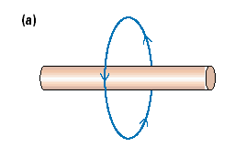
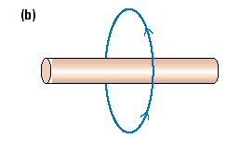
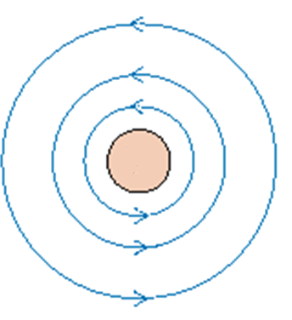
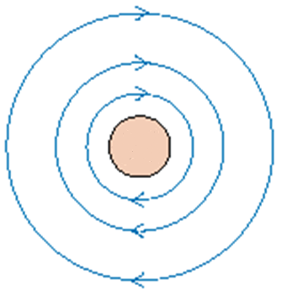
Let’s try…draw the direction of the conventional current in each case.
c) d)

Slide 8
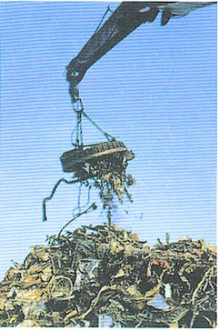
If we can increase the magnetic field around a conductor then we can use the magnetic field!
A crane in a junk yard, can turn its magnetic field off and on to lift a pile of scrap metal and release it using electricity

Slide 9
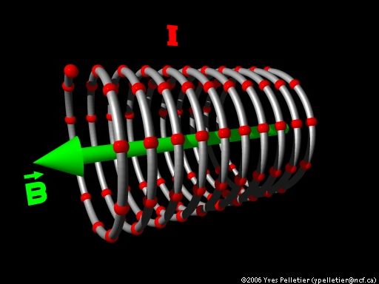
Solenoid
A solenoid represents a coiled loop of wire
Current flows through the coiled loop and creates a magnetic field around the solenoid.
A solenoid is a type
of electromagnet

Slide 10
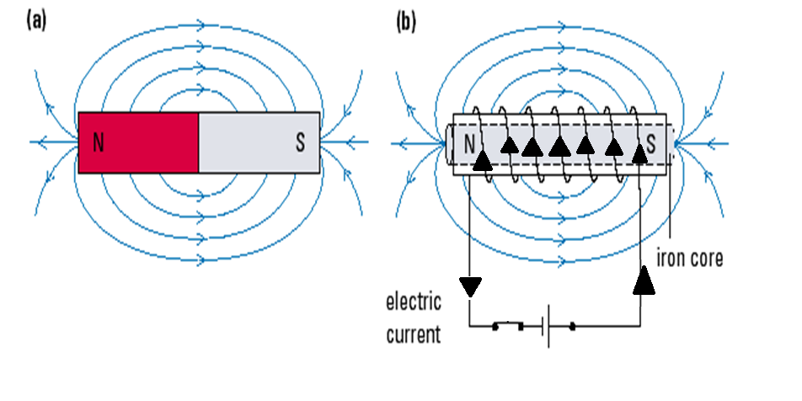
The magnetic field of a solenoid looks like a bar magnet!!
Solenoid

Slide 11
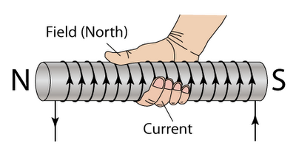
Right Hand Rule #2
•_________ curl in the direction of current flow through the conductor
• _______ points in the direction of the induced magnetic north (N)

Slide 12
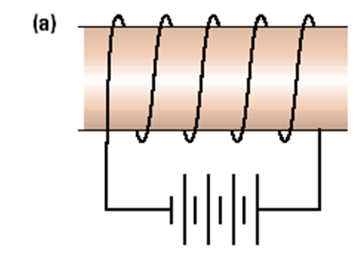
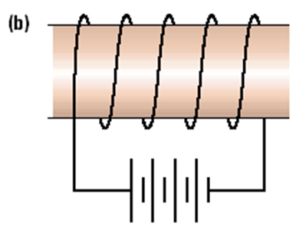
Let’s try...
Indicate the direction of the electric current and the north and south poles of the coil.
Factors that affect Strength of the Magnetic Field
Current in the coil, I
Number of turns in the coil,
3)Type of material in the coil’s centre

